Slide 1



مبادره وزارة الإتصالات و تكنولوجيا المعلومات
لتمكين الشباب للعمل المهنى الحر
Youth enablement for freelancing

Slide 2
Web Programming
Project Name : Dwa2y
Supervised by : eng/ Mohamed Khairy
Created by : Mariam Medhat Mohamed Omar

Slide 3
Description
Dwa2y: It is a web complex for pharmacies.
Dwa2y: Help the user will be able to enter a specific pharmacy and it will be divided into categories, a part for hair care and skin care, a part for man’s supplies, a part for children, and so on in each pharmacy, and it is possible for the user to enter into any category he wants and see the product and its price and Some information about it, and it is possible for the user to request the product he wants and the method of payment in cash.

Slide 4
Project tools
HTML 5
CSS
BOOTSTRAP
JAVASCRIPT
JQUERY
MY SQL
PHP

Slide 5
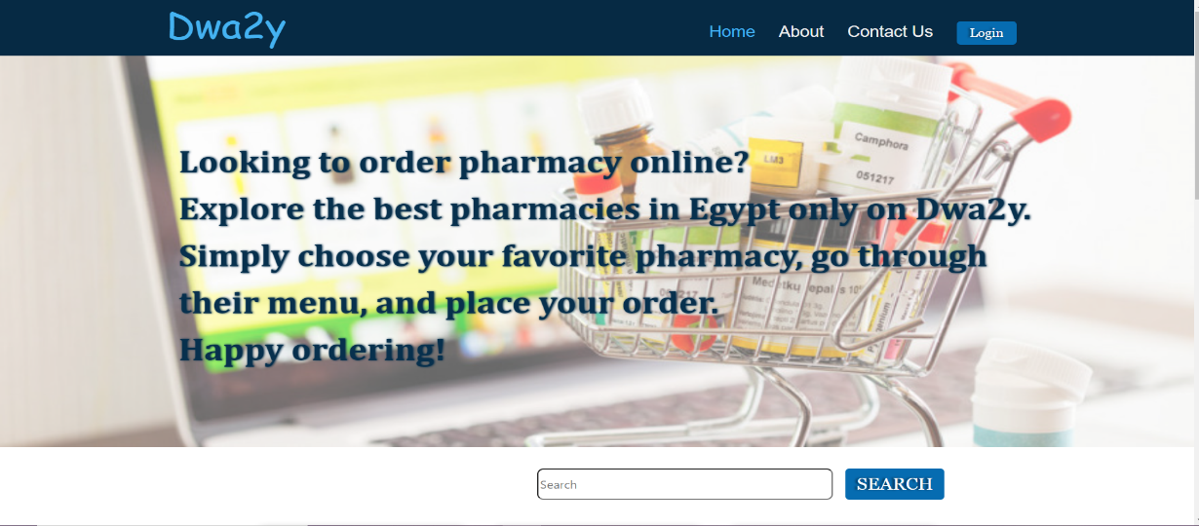
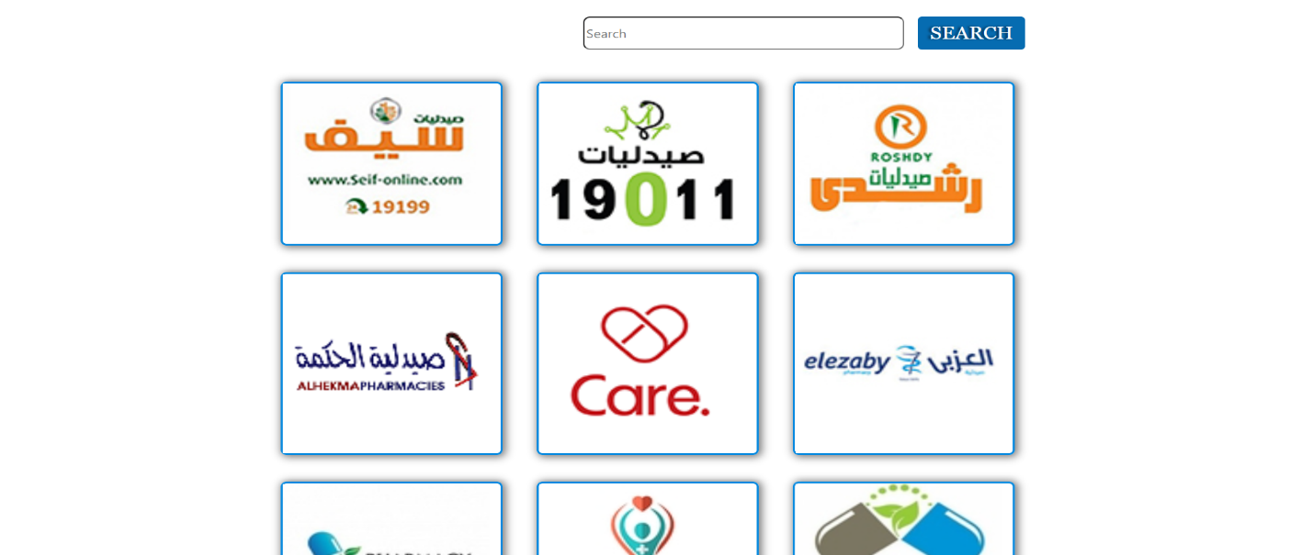

Front-end
Home Page
HTML
CSS
BOOTSTRAP

Slide 6
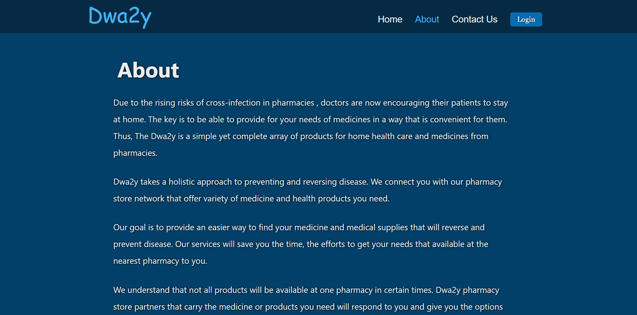
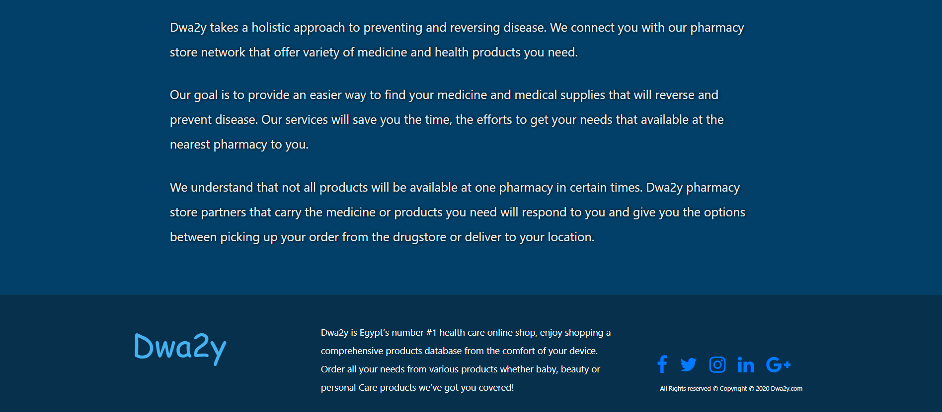
Front-end
About Page
HTML
CSS
BOOTSTRAP

Slide 7
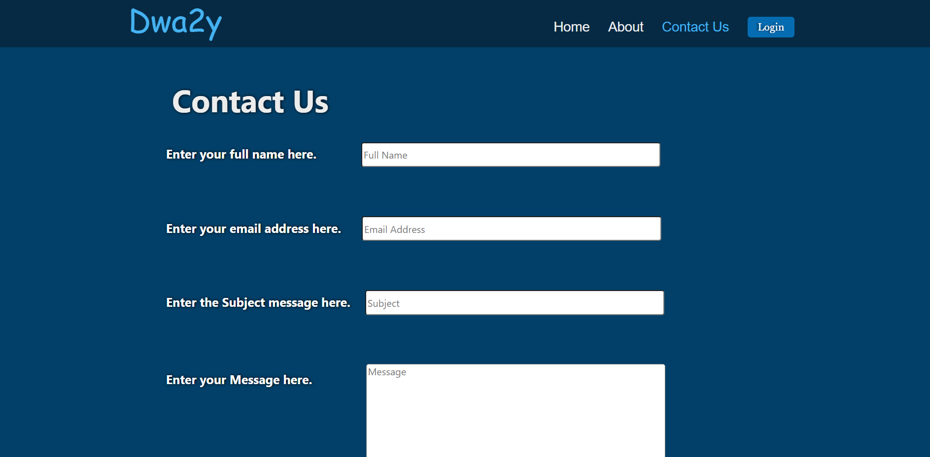
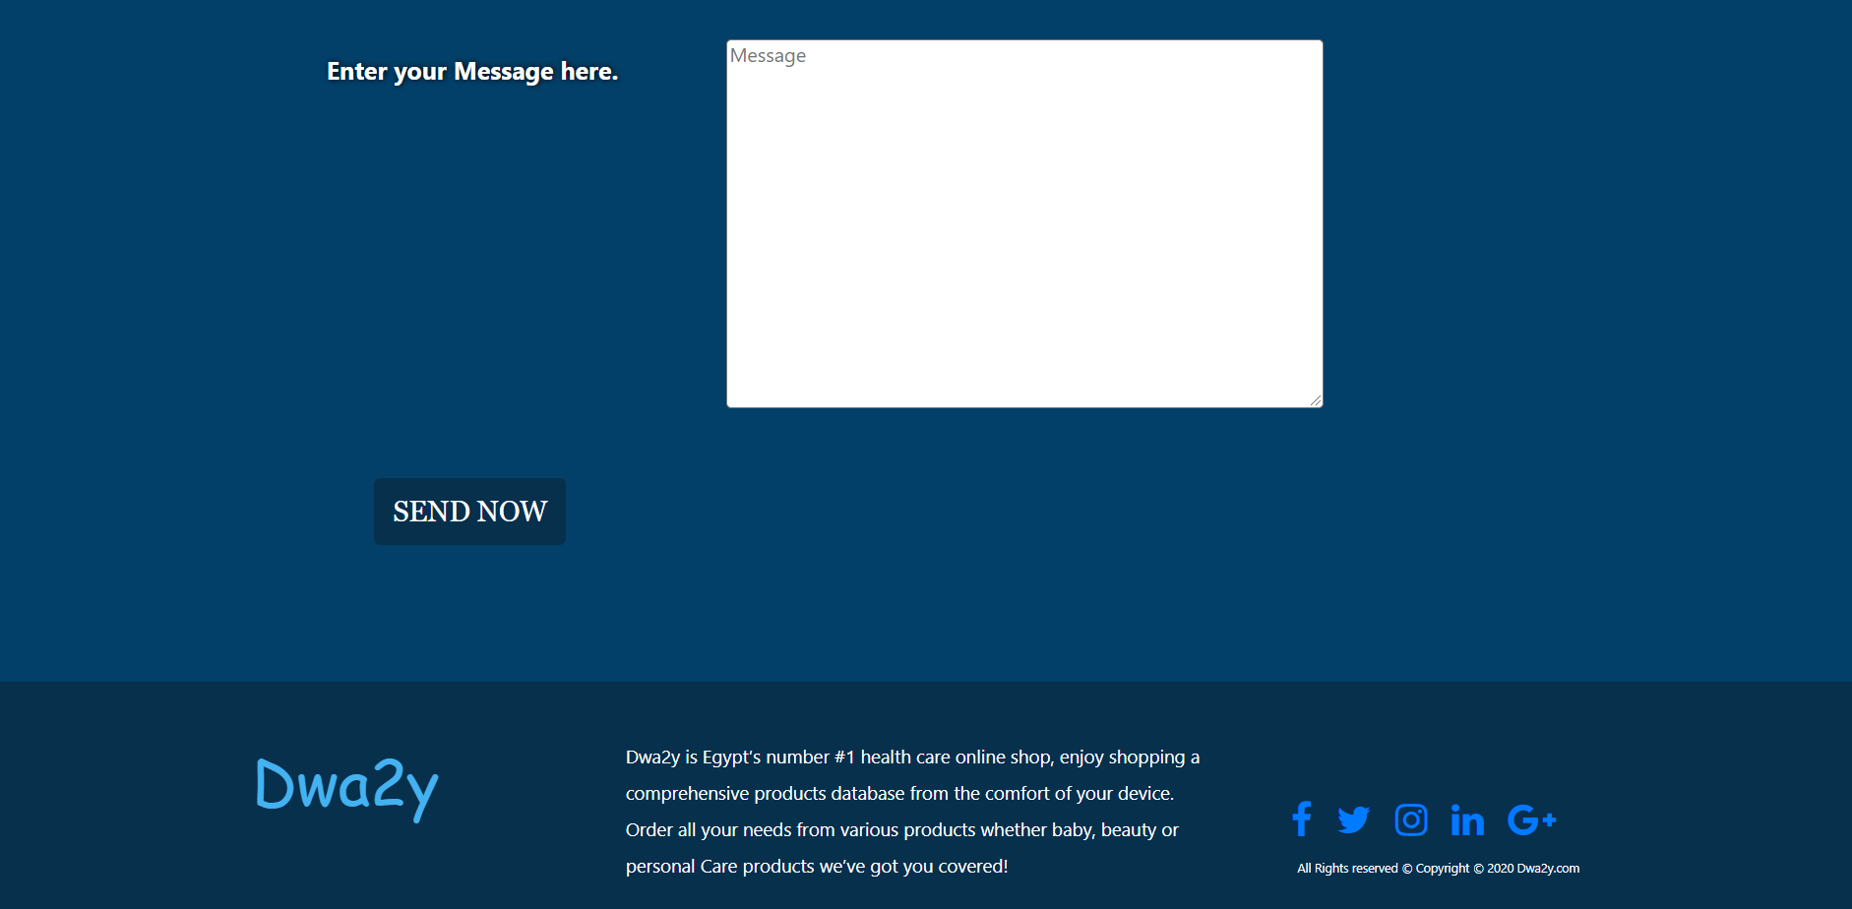
Front-end
Contact Page
HTML
CSS
BOOTSTRAP

Slide 8
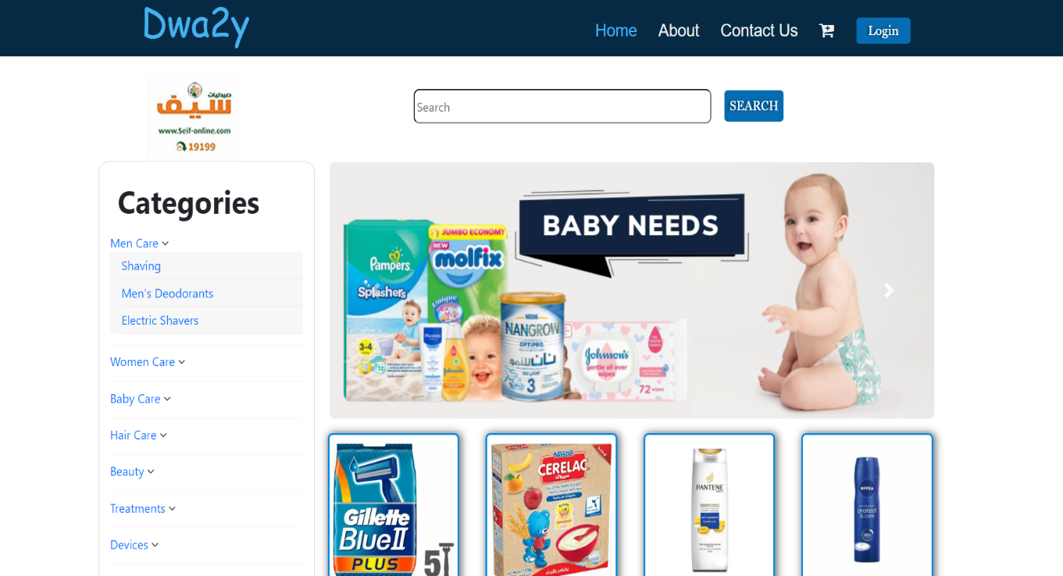
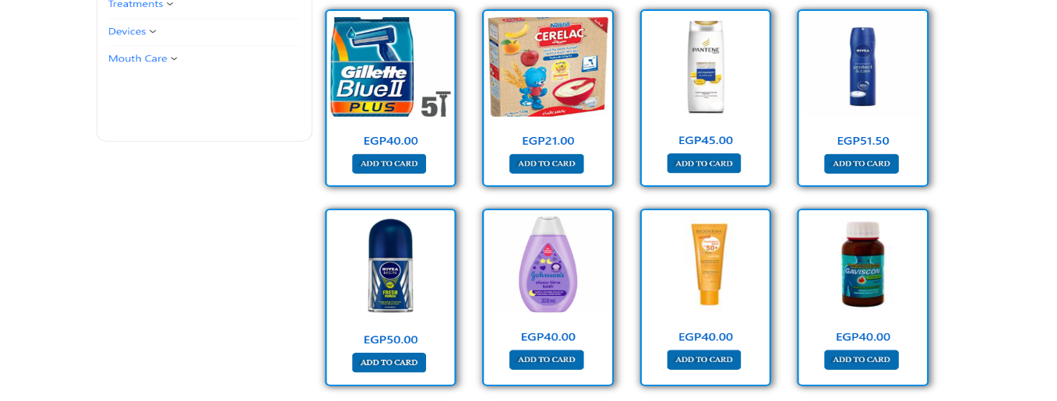
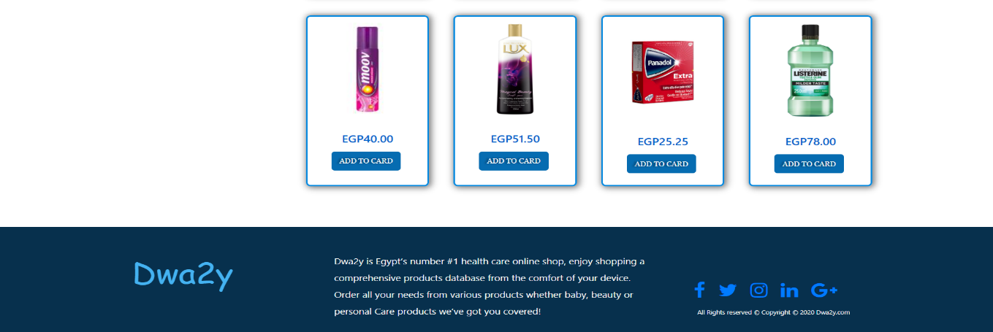
Front-end
Pharmacy Page
HTML
CSS
BOOTSTRAP

Slide 9
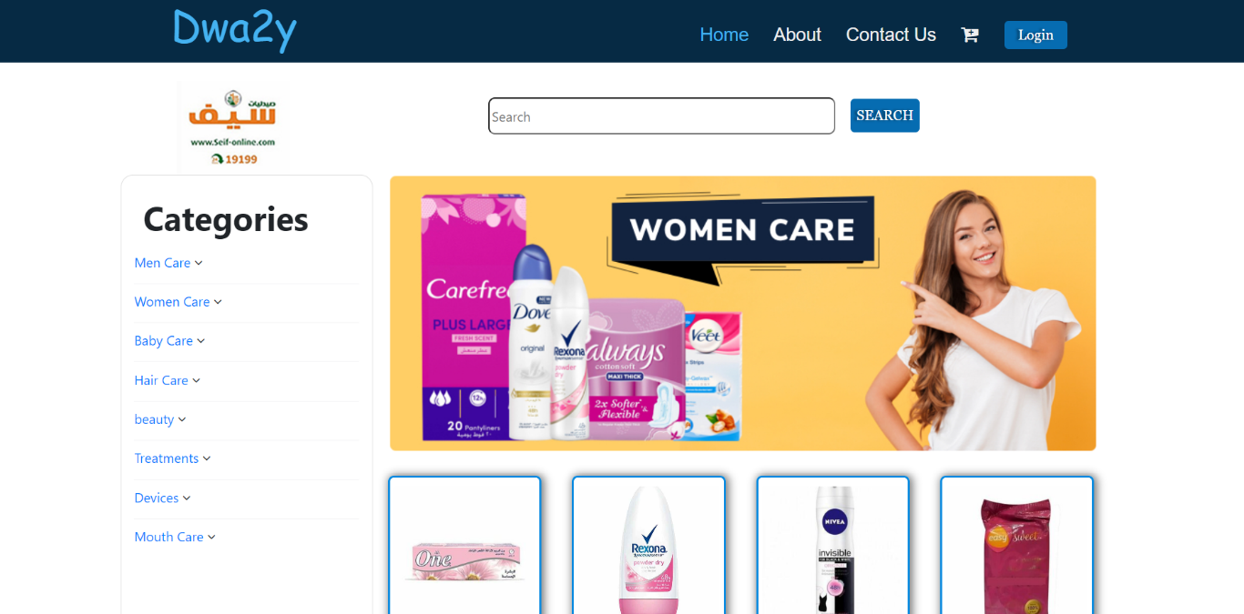
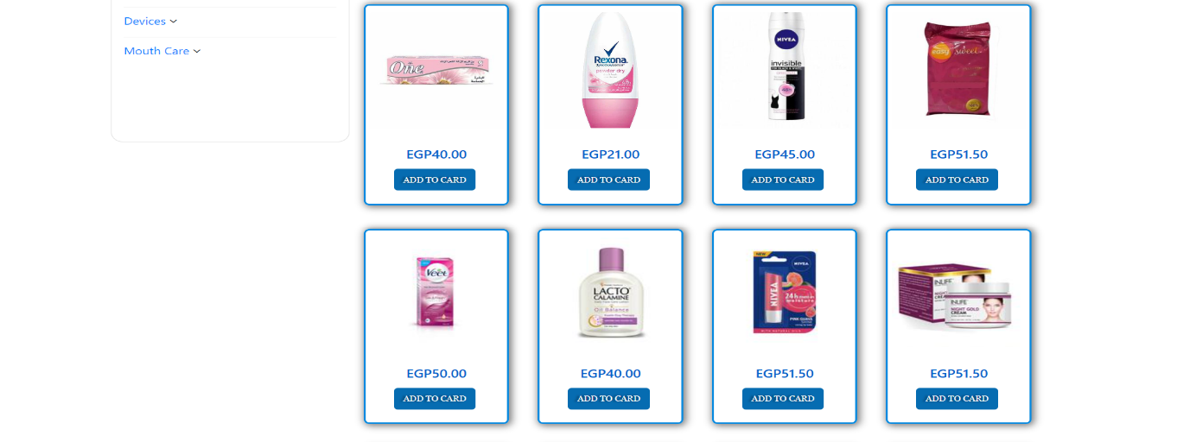
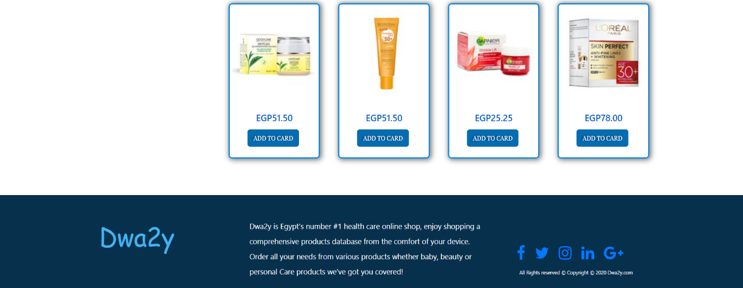
Front-end
Category Page
HTML
CSS
BOOTSTRAP

Slide 10
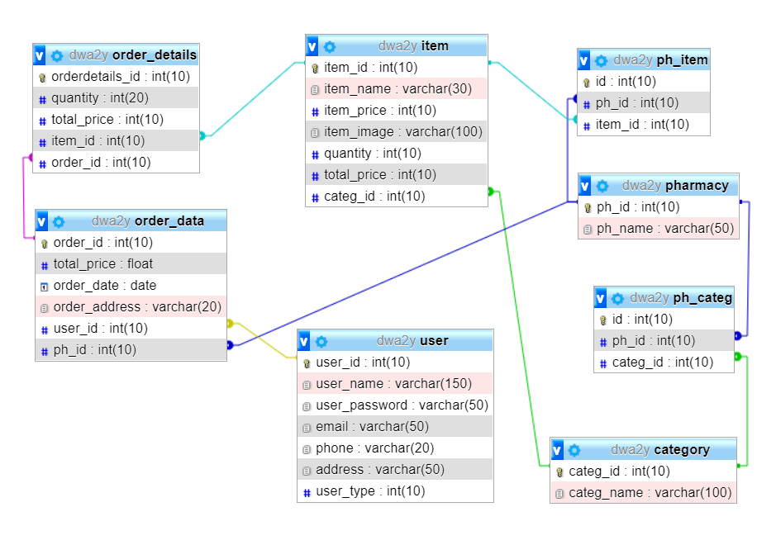
Back-end
Database
MY SQL

Slide 11
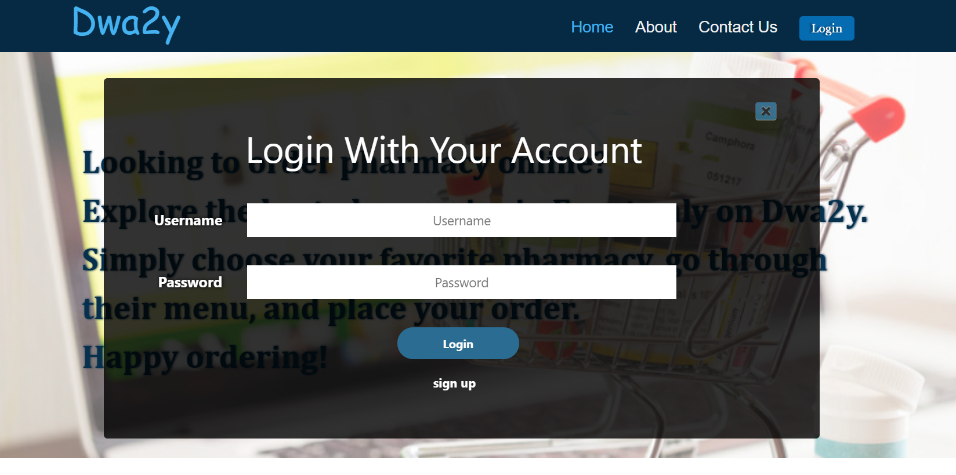
Back-end
Login Page
HTML
CSS
JAVASCRIPT
MY SQL
PHP

Slide 12
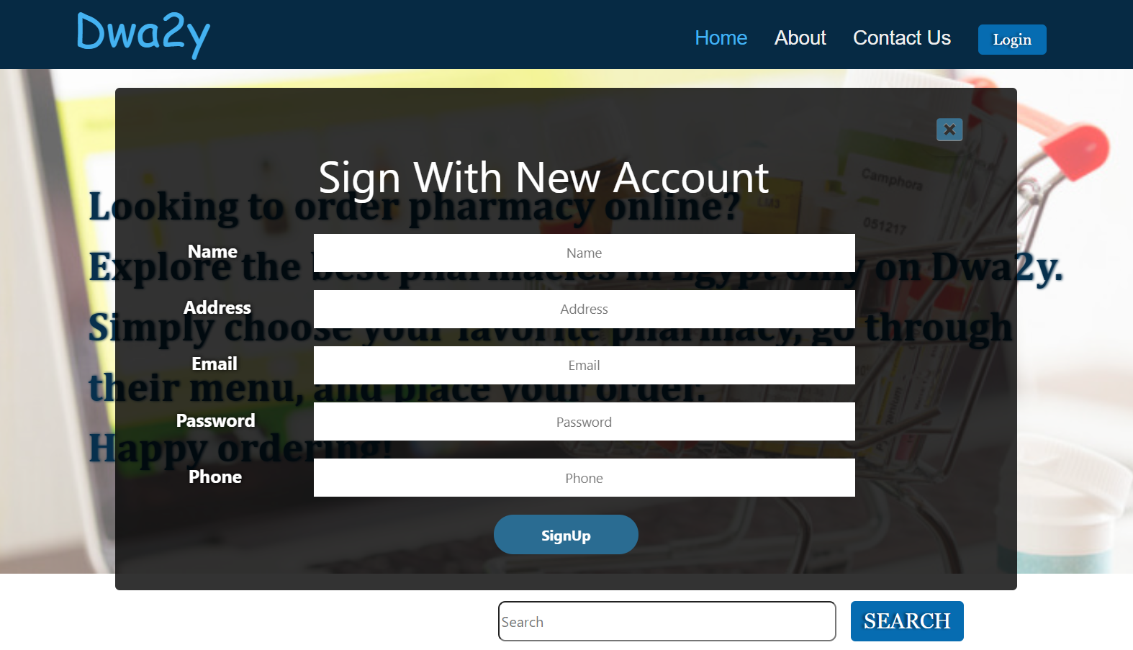
Back-end
Signup Page
HTML
CSS
JAVASCRIPT
MY SQL
PHP

Slide 13
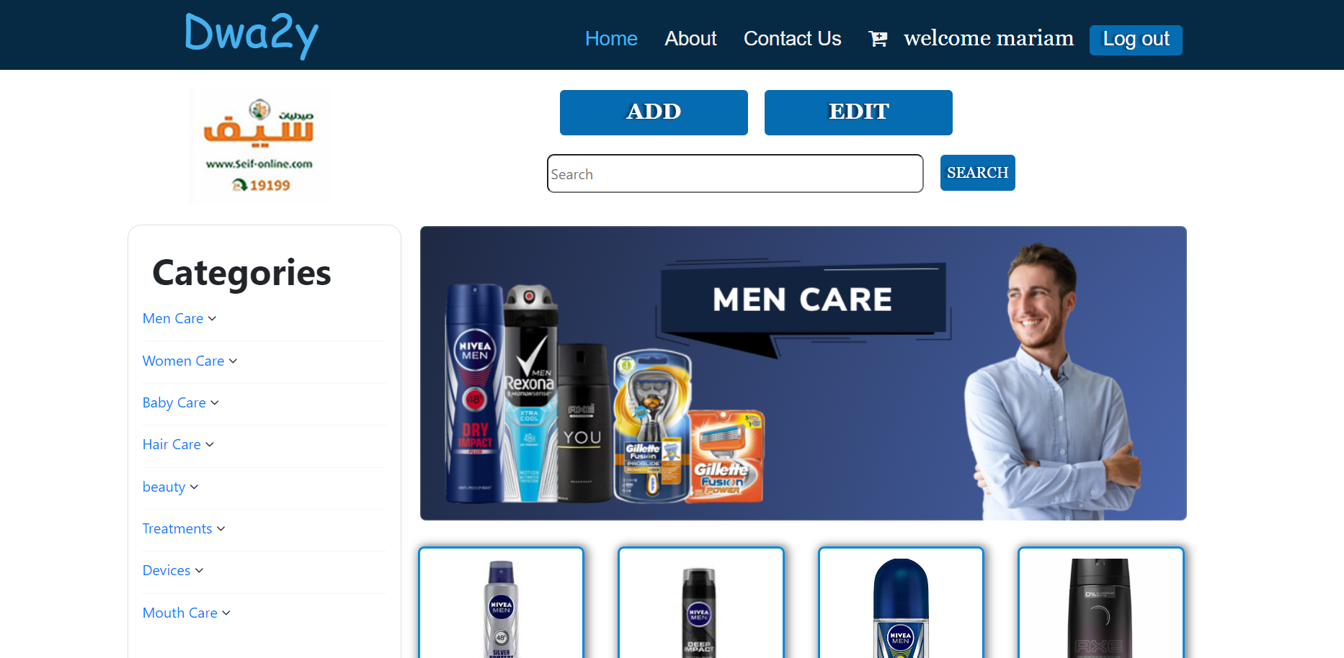
Back-end
Admin Page
HTML
CSS
MY SQL
PHP

Slide 14
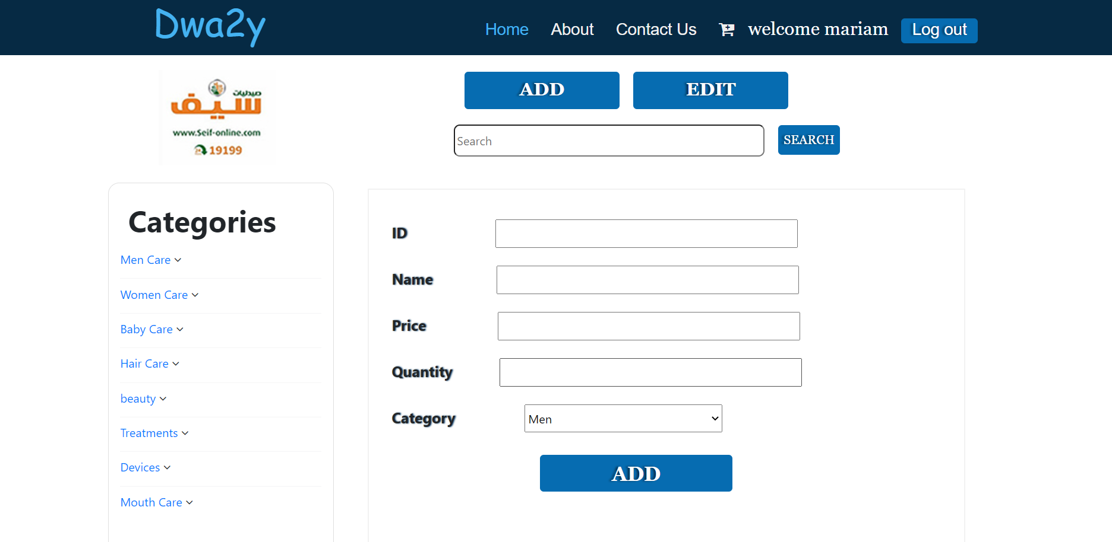
Back-end
Add Page
HTML
CSS
MY SQL
PHP

Slide 15
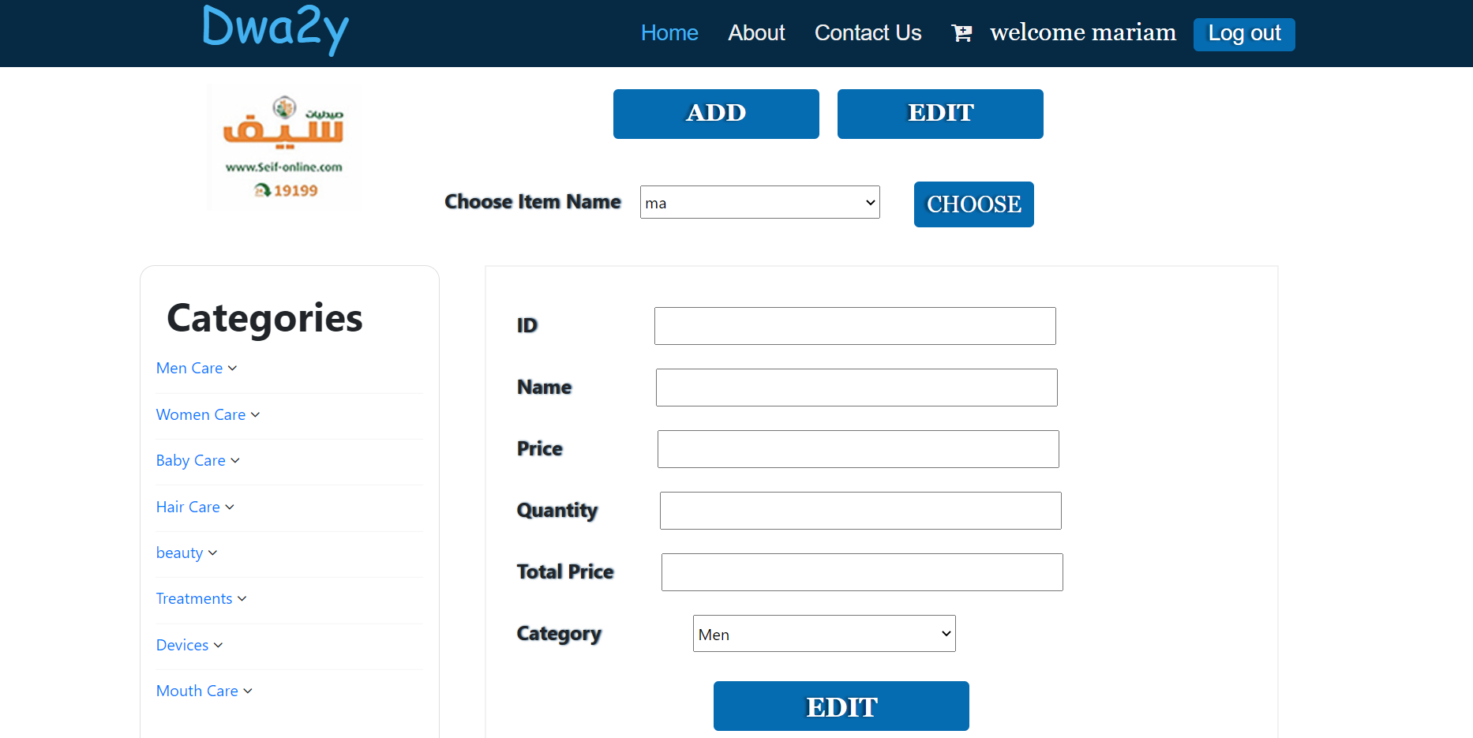
Back-end
Edit Page
HTML
CSS
MY SQL
PHP

Slide 16


